Slide 1



Board Development Series
Strategic Thinking:
Examining Your Mission
December 10, 2015

Slide 2

Outcomes
Working Collaboratively
Understand how great organizations collaborate
Think strategically concerning the school’s mission
Reflect on next steps for moving to a strategic thinking organization
Notes:
Review outcomes listed on the slide

Slide 3

Agenda
Welcome
Working Collaboratively
Strategic Thinking –
Starting with the WHY
Strategic Thinking
Analysis or Synthesis?
Action Planning
Notes:
Review agenda on the slide:
Agenda
Welcome – 5 minutes
Working Collaboratively – 15 minutes
Strategic Thinking - Start with the “WHY” – 20 minutes
Strategic Thinking – Analysis or Synthesis? – 30 minutes
Action Planning – 10 minutes

Slide 4

Working Collaboratively
Notes:
All great organizations work with a high level of synergy that is based on trust

Slide 5

Three Types of Trust
Organic
Contractual
Relational
Notes:
There are three primary types of trust (organic, contractual and relational trust)
Organic trust is the type that derives from organizations like churches and schools
Contractual trust is the type that is founded just as the name states on some contractual agreement – usually based on a deliverable or service
Relational trust is the most important when working collaboratively.
It is grounded in the social respect that comes from the kinds of social discourse that takes place in the school community – the school itself and the Board interactions.
Marked by genuine listening to what each person has to say and taking these views into account in subsequent actions.
Even when individuals disagree, they can feel valued if others respect their opinions
Personal regard represents another important criterion in working collaboratively.
This springs from the willingness of leadership and Board members to extend themselves beyond the formal requirements of the job definition.
Personal Integrity also shapes any collaborative work.
We usually ask the question…Will this person keep his word?
Integrity also demands that the moral and ethical perspective guides a person’s work
Why were you so connected to keynote speaker, Principal Wayman at the Center’s Annual Conference? Because her moral and ethical compass drove her passion and her work. There was no question as to why she was doing the work she was doing.
Conclusion: Before great organizations can do great work they MUST have strong relational trust. If they do not, the work will be mediocre at best.
Transition: Let’s suppose your school and Board has great relational trust. Sometimes, when working collaboratively, people think that the work of thinking strategically is straight forward like this… (ADVANCE SLIDE)

Slide 6
The “Normal” of Working Collaboratively
End
Start
Notes:
People often think that the “normal” of collaborative work is very neat and orderly – a straight line that has a starting point and an ending point. The “normal” of working collaboratively certainly does have a start and an end; however, it often looks for like this…(ADVANCE SLIDE)

Slide 7
The “Normal” of Working Collaboratively
End
Start
Notes:
The “normal” of working collaboratively related to strategic thinking is more like organized chaos - very messy!

Slide 8
The “Normal” of Working Collaboratively
End
Start
Notes:
Strategic Thinking and the “normal” of working collaboratively does have clear start and end; however often parties engaged in this work get lost in the “swirl” in the middle

Slide 9
The “Normal” of Working Collaboratively
End
Start
Notes:
Many good organizations start the process well, but somewhere in the middle, because they did not anticipate the “chaos,” or the stress of thinking strategically causes the “ugly” to come out – lack of collaborative culture, lack of trust, too many egos in the room without the moral and ethical compass as the guide – QUIT!
This is just to encourage you that the work IS messy, there are many bumps in the road; however, it is well worth it because it has a high moral and ethical purpose…(ADVANCE SLIDE)

Slide 10





The Moral and Ethical Imperative
End
Notes:
THE KIDS!
Transition: How can we better work collaboratively and survive the “normal” of working collaboratively? Well Simon Sinek’s work in examining great organization and great leaders has led to the foundation of Strategic Thinking…(ADVANCE SLIDE)

Slide 11
Agenda
Welcome
Working Collaboratively
Strategic Thinking –
Starting with the WHY
Strategic Thinking
Analysis or Synthesis?
Action Planning
Notes:
We are going to spend a few moments thinking about the why might be important to your organization.

Slide 12
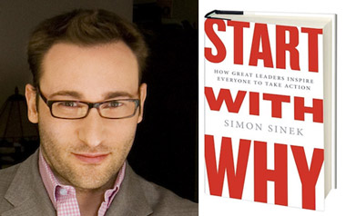

Strategic Thinking: Start with the “Why?”

Slide 13

The Golden Circle
WHY
HOW
WHAT
Concept from Simon Sinek
Notes:
Why is it that some leaders and organizations are able to inspire greater loyalty and engagement among their
customers and employees alike? How are they are able to achieve and sustain inordinate amounts of success for years on end?
Whether they realize it or not, all great and inspiring leaders and organizations think, act and communicate in the same way... and it is the complete opposite from everyone else.
Every single organization on the planet, even our own
careers, function on three levels:
1. What we do
2. How we do it, and
3. Why we do it.
When those three pieces are aligned, it gives us a filter through which to make decisions. It provides a foundation for innovation and for building trust. When all three pieces are in balance, others will say, with absolute clarity and certainty, “We know who you are,” “We know what you stand for.”
This simple idea is The Golden Circle. It is a concept discovered by optimist and author Simon Sinek.

Slide 14

The Golden Circle
WHAT
Every organization knows WHAT they do
Products they sell or the services they provide
WHY
HOW
WHAT
Concept from Simon Sinek
Notes:
Every organization and individual knows What they do.
For an organization, these are the products they sell or the services they offer.
For an individual, it is their job title or roles.

Slide 15
The Golden Circle
WHAT
Every organization knows WHAT they do
Products they sell or the services they provide
HOW
Some organization know HOW they do it
Items or services that set them apart from their competition
WHY
HOW
WHAT
Concept from Simon Sinek
Notes:
Some organizations and individuals know How they do what they do. They may call it their “differentiating value proposition,” “proprietary process” or “unique selling proposition (USP).” For a school it may be offering a technology-based program or STEM focused program. For others, it may be to foster the arts.
The Hows are an organization’s or individual’s strengths, values or guiding principles. These are the things they feel set them apart from their competition; the things they think make them special or different from everyone else.

Slide 16
The Golden Circle
WHAT
Every organization knows WHAT they do
Products they sell or the services they provide
HOW
Some organization knows HOW they do it
Items or services that set them apart from their competition
WHY
WHY
Very few organizations know WHY they do what they do
WHY is a purpose, cause or belief. It is the reason your organization exits
HOW
WHAT
Concept from Simon Sinek
Notes:
Very few people and very few organizations can clearly articulate Why they do what they do. Why is a purpose, a cause or a belief. It provides a clear answer to the questions, “Why do you get out of bed every morning?” “Why does your organization exist?” and “Why should that matter to anyone else?”
Making money is NOT a Why. Revenues, profits, salaries and other monetary measurements are simply results of what we do.
The Why is about our contribution to impact and serve others. The Why inspires us.

Slide 17
The Golden Circle
WHY
HOW
WHAT
Concept from Simon Sinek
Notes:
People naturally communicate from the outside-in; they typically go from what is easiest to understand
to what is hardest to understand and explain. They tell people What they do, tell them How they are
different or better, and then they expect a behavior like a purchase, a vote or support.
Here is how most organizations market and communicate:
What: “Here is our school.”
How: “We have the great academic programs and teachers. We have long wait lists of students that want to attend our school. And check out our parent involvement, parents love our school.
Behavior: “Come enroll your student in our school.”
The problem is that What and How do not inspire action. Facts and figures make rational sense, but people do not make decisions purely based on facts and figures. Starting with What is what commodities do. Starting with Why is what leaders do.
Leaders inspire.

Slide 18
The Golden Circle
WHY
HOW
WHAT
Concept from Simon Sinek
Notes:
Leaders and organizations with the capacity to inspire all think, act and communicate from the inside-out. They start with their Why. When they communicate their purpose or cause first, they communicate in a way that drives decision-making and behavior.
It literally taps the part of the brain that influences behavior.
Here’s an example with the same school, starting with their Why:
Why: “We believe in generating holistic designs that enable new ways of teaching and learning.
How: “We do so by bringing in some of the most intelligent educational thinkers that work out their own meanings and develop their own learning agendas, building on their successes as they go. This is built on the four principles of personalization, adult world connection, common intellectual mission, and teacher as designer.
What: “We are an educational incubator where all students develop the academic, workplace, and citizenship skills for postsecondary success.
Behavior: “Come see for yourself.”
If the people at this school actually believe in their Why and think, act and communicate starting with their Why, they will attract people who believe what they believe and who want to be a part of their cause.

Slide 19
The Golden Circle
To generate holistic designs that enable new ways of teaching and learning.
WHY
HOW
WHAT
Concept from Simon Sinek
Notes:
Leaders and organizations with the capacity to inspire all think, act and communicate from the inside-out. They start with their Why. When they communicate their purpose or cause first, they communicate in a way that drives decision-making and behavior.
It literally taps the part of the brain that influences behavior.
Here’s an example with the same law firm, starting with their Why:
Why: “We believe in servicing the needs of others
so that they can focus on the difference
they need to make.“
How: “We do so by bringing on some of the most intelligent legal professionals who graduated from the world’s top schools. We work with top performing organizations, most of which are on the Fortune 500 list, so that we can help them make a larger difference in the world. And, we like to go above and beyond, so we have built pristine offices.”
What: “We are a world-class law firm.
Come see for yourself.”
If the people at this firm actually believe in their Why and think, act and communicate starting with their Why, they will attract people who believe what they believe and who want to be a part of their cause.

Slide 20

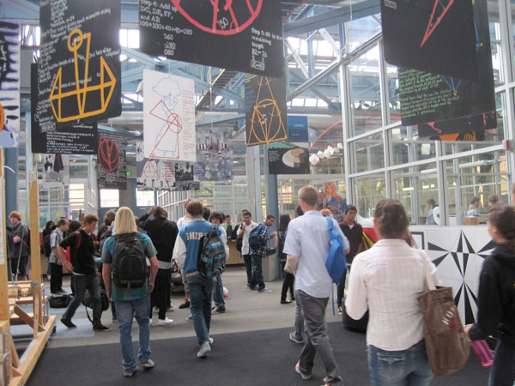
The Golden Circle
To generate holistic designs that enable new ways of teaching and learning.
Notes:
Great schools have a clearly defined WHY and the WHAT and the HOW flow from the WHY. The example shared in the previous slide is from High Tech High in California.
One of the most innovative charter schools in the country. As you can see, they have a clear WHY. This WHY drives the how and the what and becomes a filter for programming, resource allocation, hiring, etc.

Slide 21
Agenda
Welcome
Working Collaboratively
Strategic Thinking –
Starting with the WHY
Strategic Thinking
Analysis or Synthesis?
Action Planning
Notes:
As we proceed into the next section, we will be examining strategic thinking and asking is it analysis or synthesis?

Slide 22

Strategic Thinking
“Strategic planning isn’t
strategic thinking.
One is analysis and the
other is synthesis.”
Minzberg
Notes:
Minzberg has said that strategic planning isn’t strategic thinking. One is analysis and the other is synthesis.
Turn to your elbow partner and talk about which one belongs with which and why you think so.
Give about 5 minutes for this discussion.

Slide 23

Strategic Thinking
To think about, view, assess and create future success
Notes:
Let’s review the definition for strategic thinking that we will be using throughout the year.
To think about, view, assess and create future success.

Slide 24

Road Map of Strategic Thinking
Notes:
Transition: There are several ways for us to begin thinking strategically about our schools. (ADVANCE SLIDE)

Slide 25

Road Map of Strategic Thinking
Clarity of WHY
Discipline of HOW
Consistency of WHAT
WHY
HOW
WHAT
Notes:
For The Golden Circle to work properly, you must have:
1. Clarity of Why,
2. Discipline of How, and
3. Consistency of What.
No one section of The Golden Circle is more important than the other. The most important thing is a balance across all three.
WHY:
If you don’t know Why you do What you do, how can you expect anyone else to know? For others to know your Why, you must first have clarity of your own Why.
HOW:
The actions that you and your people take to bring your cause to life must be aligned with your values, guiding principles, strengths and beliefs.
WHAT:
And everything you say and everything you do must be consistent with what you believe. After all, we live in the tangible world. The only way people will know what you believe is if you say and do the things you actually believe.
Transition: There is not one right way to begin this strategic thinking process. There are actually several ways that will get you there. Today, we are just going to engage in one way…first by Examining the Mission.
ACTIVITY: Let’s take a look at some mission statements together. You are going to read the mission statement, and as a table group see if you can determine what organization has that mission statement.

Slide 26


Examining a Mission
“To attract and attain customers with high-valued products and services and the most satisfying ownership experience in America.”
Notes:
Complete activity listed on slide 25

Slide 27

Examining a Mission
“_______improves lives by mobilizing the caring power of communities around the world to advance the common good.
Notes:
Complete activity listed on slide 25

Slide 28

Examining a Mission
“To bring inspiration and innovation to every athlete* in the world.”
*If you have a body, you are an athlete.
Notes:
Complete activity listed on slide 25

Slide 29
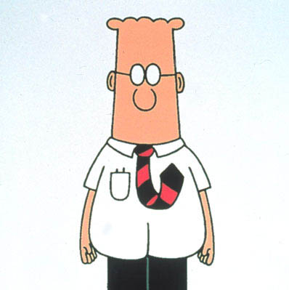
Examining a Mission
“The customer can count on us to continually fashion economically sound paradigms so that we may endeavor to enthusiastically engineer cutting edge infrastructures.”
Notes:
Complete activity listed on slide 25

Slide 30

Examining a Mission
Notes:
All of these organizations are very clear about who they are and what they do. More importantly, they are clear about their WHY (well, except for Dilbert) which inspires people.

Slide 31
Examining a Mission
Help people go places in life
Bring inspiration and innovation
Unite people as a community
Notes:
Toyota’s Why – Help people go places in life.
United Way – Unite people as a community. (Stablize families, help children succeed, create healthy living)
Nike – Interestingly enough, Nike’s mission is also their WHY
Bring inspiration and innovation
Transition: Let’s examine one final mission statement (ADVANCE SLIDE)

Slide 32

Examining a Mission
“Respect, Integrity, Communication and Excellence.”
Notes:
Complete activity listed on slide 25
Transition: Now that you have heard about several great organization’s WHY and reviewed their mission statements, it is time for you to roll up your sleeves and do some work in reflecting on your school’s WHY and mission.

Slide 33
Dissecting a Mission
What is CORE to a mission?
Notes:
Dissecting a Mission
Each of you have a paper that has wheels and spokes. You also have your school’s mission statement. What we are going to do is take the statements of the mission and dissect the meaning and see what evidence that you have that your mission and your WHY is the foundation of who you are as an organization.
Transition: It would look something like this… (ADVANCE SLIDE)

Slide 34
Dissecting a Mission
develop and support innovative public schools where all students develop the academic, workplace, and citizenship skills for postsecondary success.
Notes:
Read sample mission statement of High Tech High
ADVANCE SLIDE…

Slide 35
Develop innovative public schools
Dissecting a Mission
develop and support innovative public schools where all students develop the academic, workplace, and citizenship skills for postsecondary success.
All students develop citizenship skills for
postsecondary success
Support innovative public schools
All students develop workplace skills for
postsecondary success
All students develop academic skills for
postsecondary success
Notes:
Each statement of the mission statement is placed on a spoke. You should then ask yourself the question…
What evidence is there in my school that this statement is true – “living and breathing?”
How will we know that we are remaining true to this mission statement?

Slide 36


Slide 37

Be Prepared
Don’t Jump to Confusion

Slide 38

Next Steps
Notes:
What needs to come next for our Board or school to continue to think strategically?

