Slide 1
Future Success:
The Importance and Process of Board Succession Planning
BDS| October 15, 2015
Orlando Castellon
Director for Board Appointments and Development
The Governor John Engler Center for Charter Schools | Central Michigan University

Slide 2
CASE STUDY
What is the most important issue in this case?
What do you think should be done first to address the issue?
What could have been done differently to avoid the situation entirely?
Notes:
The primary responsibility of a board, following the establishment of the mission and direction of the organization, is the hiring of the CEO.
What is the responsibility of the charter school board that has an ESP/EMO?
Simons actions demonstrate that CEO’s need board governance training also.
CMU’s experience in delivering BDS- Start-up, Clear expectations, relationship building, common sense of purpose.
CMU’s experience in offering board development- with CEO’s

Slide 3
GOALS
Discuss how to build boards through identifying and developing effective candidates
Disseminate best practices to enhance board activities and make boards more effective
Share resources to utilize in achieving effective governance

Slide 4
WHAT IS THE ROLE OF THE BOARD?
Ten Basic Responsibilities of Nonprofit Boards
Board Source – Richard T. Ingram
Charter School Board University: An Introduction to Effective Charter School Governance
National Charter Schools Institute – Brian Carpenter
Trustee Handbook: A Guide to Effective Governance for Independent School Boards
National Association of Independent Schools – Mary Hundley DeKuyper
Board Essentials
The Governor John Engler Center for Charter Schools at Central Michigan University
Notes:
Resources…
Introduce all of the resources
All of these resources have common threads or themes that run through them… Mission- Give examples, Fiscal- give examples
Doesn’t matter which publication or you choose but it is critical that the board has a common language with administration.
Need to have something that all stake holders can buy into and that fits the culture of the organization.

Slide 5
WHAT IS THE ROLE OF THE BOARD?
1. Know and support the mission and founding documents
2. Ensure effective planning
3. Create accountability
4. Ensure fiscal resources and provide oversight to resources
5. Board building
6. Effective communication and ambassadorship

Slide 6
WHAT IS THE ROLE OF THE BOARD?
ACHIEVE GREATNESS

Slide 7
HOW DOES THE BOARD ACHIEVE GREATNESS?
JIM COLLINS – GOOD TO GREAT
“A great organization is one that delivers superior performance and makes a distinctive impact over a long period of time.” - Jim Collins
“Greatness is not a function of circumstance. Greatness, it turns out, is largely a matter of conscious choice, and discipline.” - Jim Collins

Slide 8
GOOD TO GREAT FRAMEWORK
DISCIPLINED PEOPLE
First Who… Then What
Those who build great organizations make sure they
have the right people on the bus
have the wrong people off the bus
have the right people in the key seats
then figure out where to drive the bus
Level 5 Leadership
Level 5 leaders are ambitious first and foremost for the cause, the organization, the work – not themselves.
Displays a paradoxical blend of personal humility and professional will.

Slide 9
WHAT IS THE ROLE OF THE BOARD?
1. Know and support the mission and founding documents
2. Ensure effective planning
3. Create accountability
4. Ensure fiscal resources and provide oversight to resources
5. Board building
6. Effective communication and ambassadorship

Slide 10
WHAT IS THE ROLE OF THE BOARD?
ACHIEVE GREATNESS

Slide 11
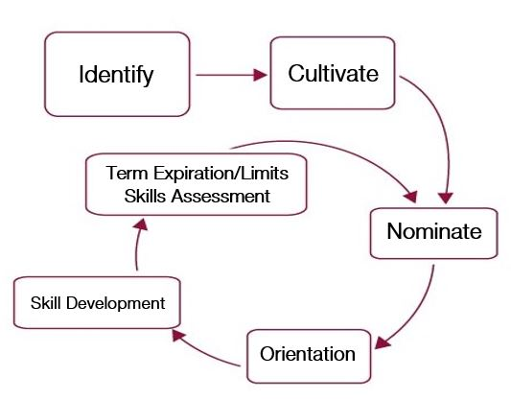
STRATEGIES TO CULTIVATE GOOD GOVERNANCE
BOARD BUILDING

Slide 12
CASE STUDY
What is the most important issue in this case?
What do you think should be done first to address the issue?
What could have been done differently to avoid the situation entirely?
Notes:
Lack of process
Hadn’t completed a needs assessment
Lack of due diligence
Should the board prepare a press statement

Slide 13
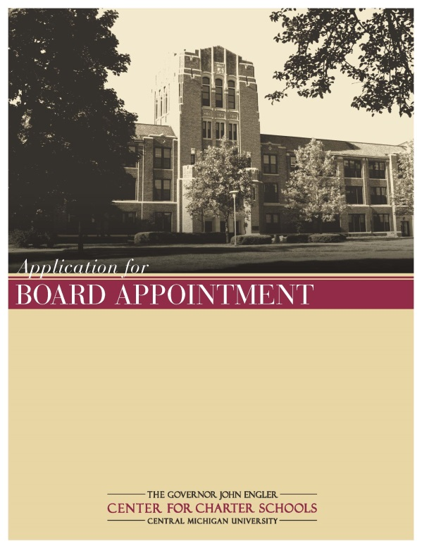
IDENTIFY
It’s important to know who you
are and what skill sets you
have on the board.
What skills are you looking for?
Where do you go to identify a
good candidate?
Notes:
Need for an accounting for who you have on the board of directors. What skills do they possess? Develop a board profile. Be thoughtful about diversity. Think about immediate needs and long term needs.
Need for some sort of application- show CMU application: should identify contact information, skill sets the candidate possesses, potential conflicts of interest, request for permission to run a criminal background disclosure/check. Be sensitive about the types information you are collecting.
As part of the application, identify the process.
Local chamber of commerce, Local charities or nonprofits- U-way, Big Bro, YMCA; colleges or universities, former students
Identification is kind of like dating.
We wouldn’t jump into a long term relationship without knowing who we were getting into that relationship with.
What are the term lengths in your state?
Multi-million dollar operation with the use of public funds- cohesion is necessary.
Should be the work of the entire board.
Important to pay attention to conflicts.
Important to ensure that the recruits that you identify understand and agree ideologically with the mission, vision and organizational structure.

Slide 14
CULTIVATION
Build relationships
Can be the work of a committee
Should include a menu of options for involvement
Develop board member information sheet
Notes:
The idea behind cultivation is to build good will for your school community. Making community members ambassadors for your school by getting them involved. We are not putting them on the school board yet… Not marriage but dating. I don’t like the idea of turning away potential board members or supporters of your organization. Cultivating potential board members should be an ongoing activity so that when the time comes to nominate someone you have a pool of individuals to choose from.
There needs to be a framework that is established. Intentional process. Every board should consider a governance committee. Governance, Finance or Audit, fundraising, policy committee. Service to a committee allows the board to evaluate how that candidate will fit into your board. Kind of like Dating. Farm system.
this could range from inclusion on mailings like your annual report or news letters, invitations to special school events, may involve committee work, or volunteering in the school
There are multiple examples of information sheets in the various resources that we have previously identified. See board building cycle pg. 17
Be sure to make it known that not everyone who is invited to take an active role in supporting the school will end up as a board member. Therefore cultivation with each candidate may take on a different approach.
Caution: Relationships- Spouces, boss employee

Slide 15
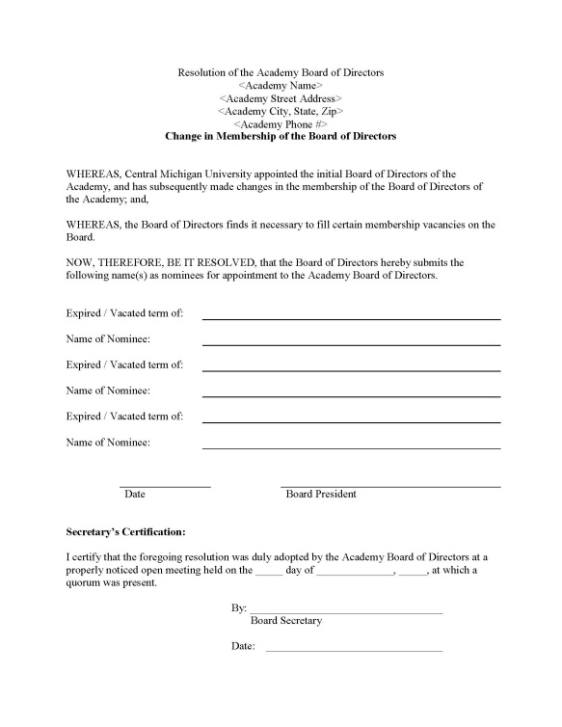
NOMINATE
Formal and transparent process
Ensure overall consensus
Board self-evaluation
Notes:
The nomination process is the formal part of the process depending on the state that you operate in. In Michigan, board members become public officials. So its important for us that we follow the formality of the process. Be sure to understand the law in your state as well as the bylaws of the school boards.
Board appointments have the opportunity to create divisions on the board. Having a process of identifying skills necessary to move the school forward will help to eliminate this potential.
Jim Collins- First who then what

Slide 16
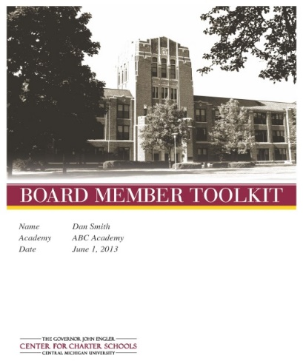
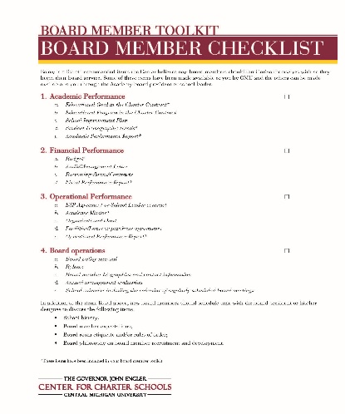
ORIENTATION
Develop a process
How do you organize
the process?
Who should be included
in the process?
Not an overnight process
Notes:
While the board may have previously completed this process, this is a good time to re-evaluate your needs. Can be organized through a committee. Some groups advocate for a governance committee. Orientation should start out broadly and narrow in over time. Some broad topics include roles and responsibilities of affiliated parties. Some specific topics may include programmatic offerings.
Governance committee should establish and guide the process of recruitment and orientation but finding and training board members belongs to the entire organization. This may be governance committee work that should filter up to the entire board as recommendations.
Process may include authorizer, board, Principal/CEO/school leader, business manager, founder, teachers or program officer. Really will depend on the school, program offerings, mission, ect.
Discuss CMU orientation process and share contents of orientation binder.
May take a year for a board member to feel as if they have a complete understanding due to the nature of the school year and different things happening in a school at different times.

Slide 17
SKILL DEVELOPMENT
Why do we need skill
development?
Who can help us with
skill development?
What should skill
development look like?
Notes:
Governance and management are very different skill sets. Many of our board members have extensive practice and experience with management and less experience with governance. So its important that we continue to clarify the differences. This should be an organizational effort.
Can be done through committee. We have developed what we call the BDS
Should be a component of every board meeting. It can be as simple as reading and discussing case studies, or discussion of other literature, presenter, webinars, and conferences. This doesn’t have to be difficult and complicated. Should encourage discussion and debate on the board.

Slide 18
STRATEGIES TO CULTIVATE GOOD GOVERNANCE

Slide 19
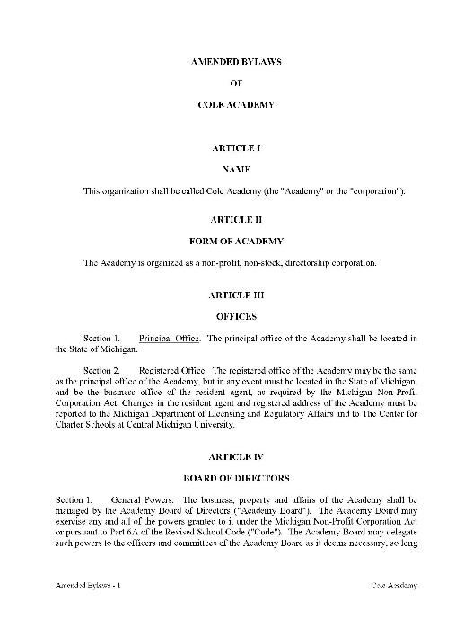
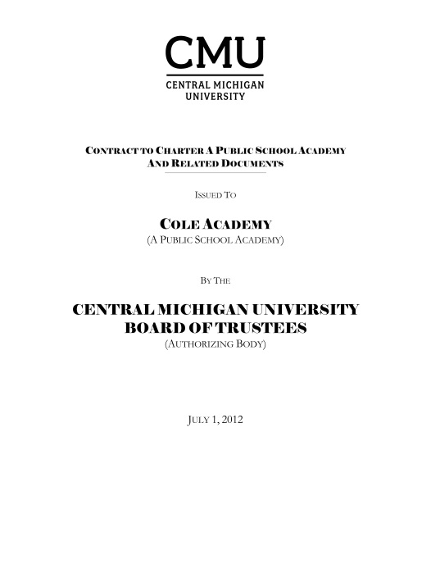
TIPS FOR BOARD SUCCESSION
Understand your bylaws
Have a record of term
expiration
Utilize a board member
self-assessment
Schedule strategic
planning
Notes:
Its critical that you continually reflect back on your founding documents. Mission, vision but also bylaws and charter contract
Your bylaws should share your term expirations and other key information for the board to know.

Slide 20
OTHER BEST PRACTICES
Board meeting packets
Meeting and agenda development
Evaluations
Conflict of interests policy/program
Staggered terms
Board member role descriptions
Others?
Notes:
One week in advance, recommendations from leadership, recommended motions, consent agendas. No surprises!
Board president and school leader should meet between board meetings. Materials for inclusion should be prepared accordingly.
Of management and the board.

Slide 21
RESOURCES
The Governor John Engler Center for Charter Schools. Board Essentials.
DeKuyper, Mary Hundley. Trustee Handbook: A Guide to Effective Governance for Independent Schools Boards. National Association of Independent Schools
BoardSource. The Source 12: Twelve Principles of Governance That Power Exceptional Boards. Board Source.
Ingram, Richard T. Ten Basic Responsibilities of Nonprofit Boards. Board Source.
Carver, John. Board That Make a Difference: A New Design for Leadership in Nonprofit and Public Organizations.
Lakey, Berit M. The Board Building Cycle: Nine Steps to Finding, Recruiting, and Engaging Nonprofit Board Members. BoardSource.
Carpenter, Brian L. Charter School Board University: An Introduction to Effective Charter School Governance. National Charter Schools Institute.
Cornell Feist, Marci. Board Meetings: A Guide for Charter Schools. The High Bar.

Slide 22
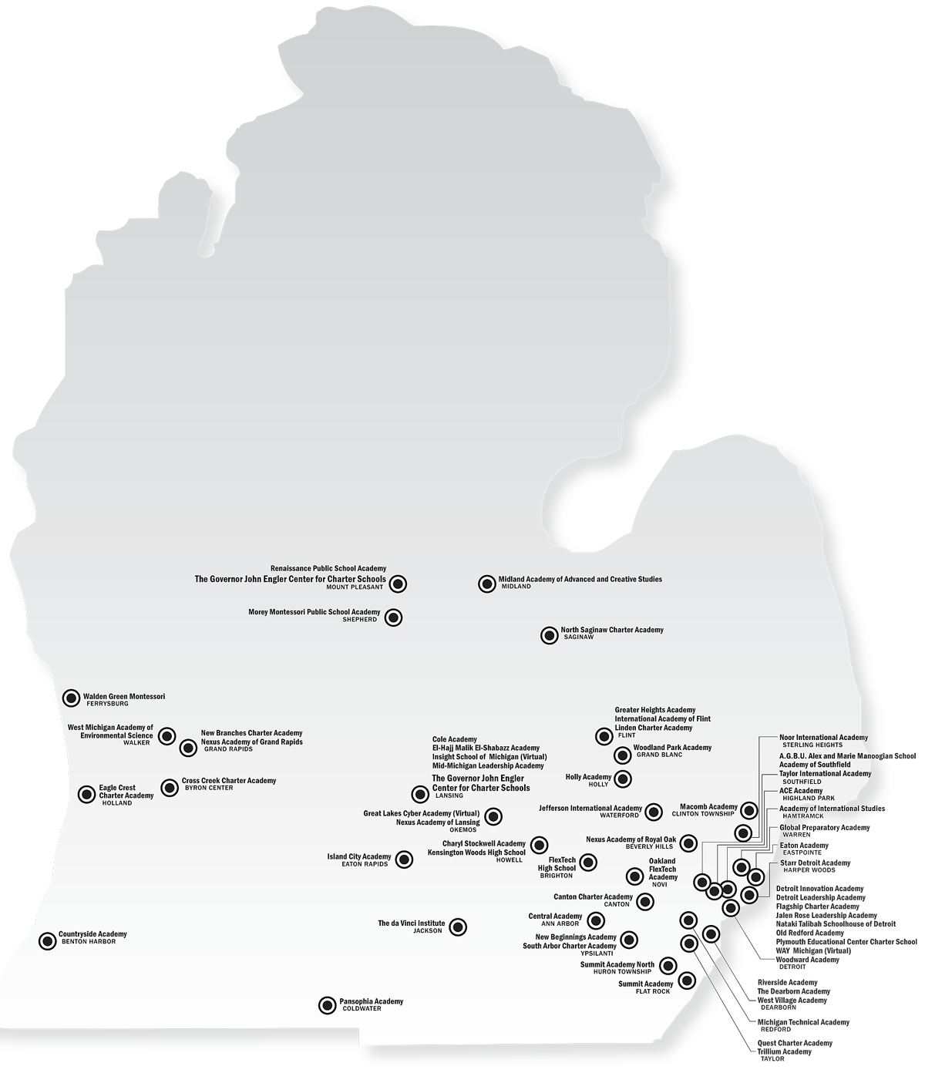
2014 - 2015 CHARTER PUBLIC SCHOOLS
AUTHORIZED BY CENTRAL MICHIGAN UNIVERSITY

Slide 23
CONTACT INFORMATION/QUESTIONS
Orlando Castellon
Director for Board Appointments and Development
989-774-2100 | ocastellon@thecenterforcharters.org

